Slide 1
Introduction to Python
Paul Gebeline
July 13, 2026

Slide 2
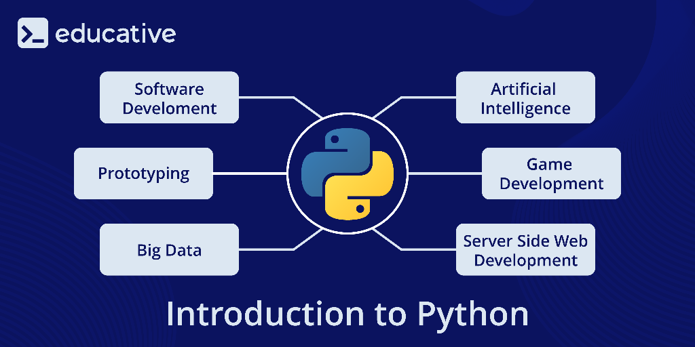
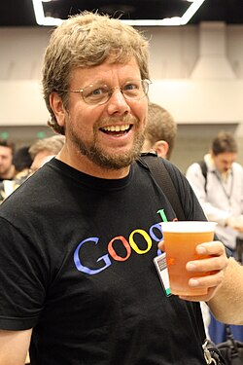
What is Python?
Python is a powerful programming language, and is the industry standard (along with C++) in particle physics
Created by Guido van Rossum and released in 1991
Known for its elegant syntax and is thus very easy to learn!

Slide 3
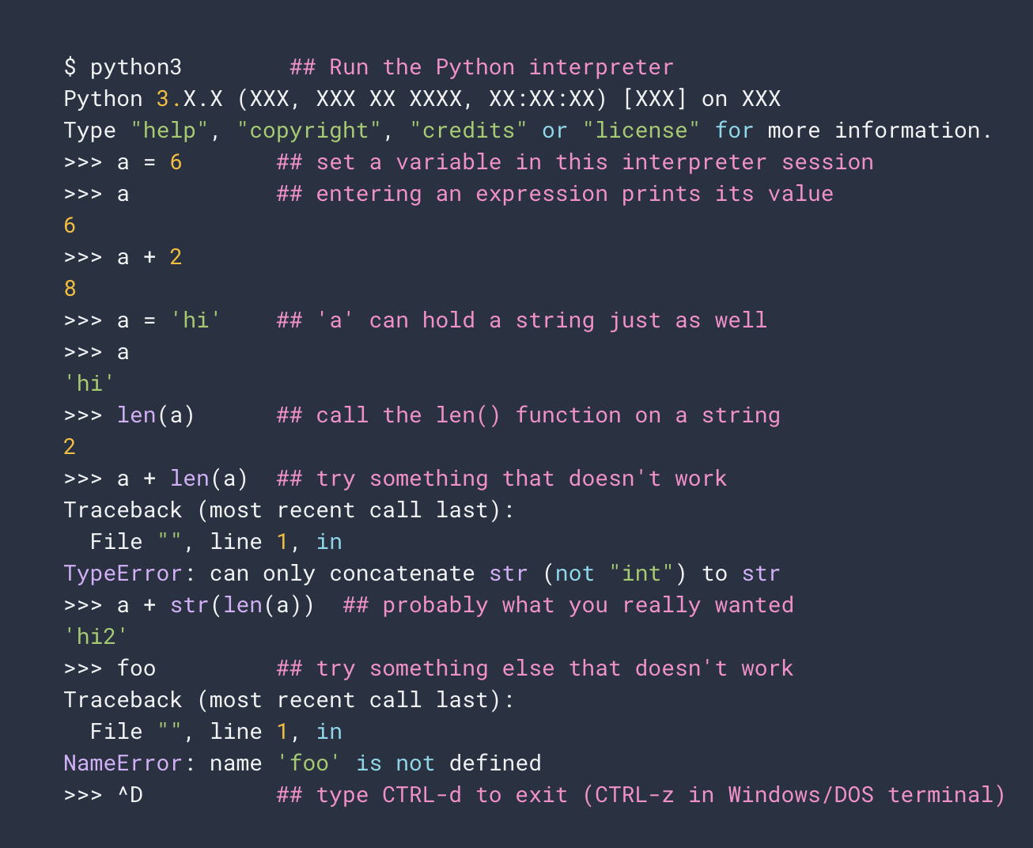
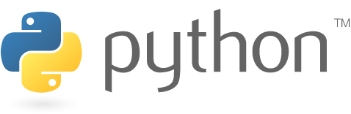
Python is a dynamic, interpreted language
  No need to compile
  No type declarations → short and flexible code
  There is an interactive interpreter

Slide 4
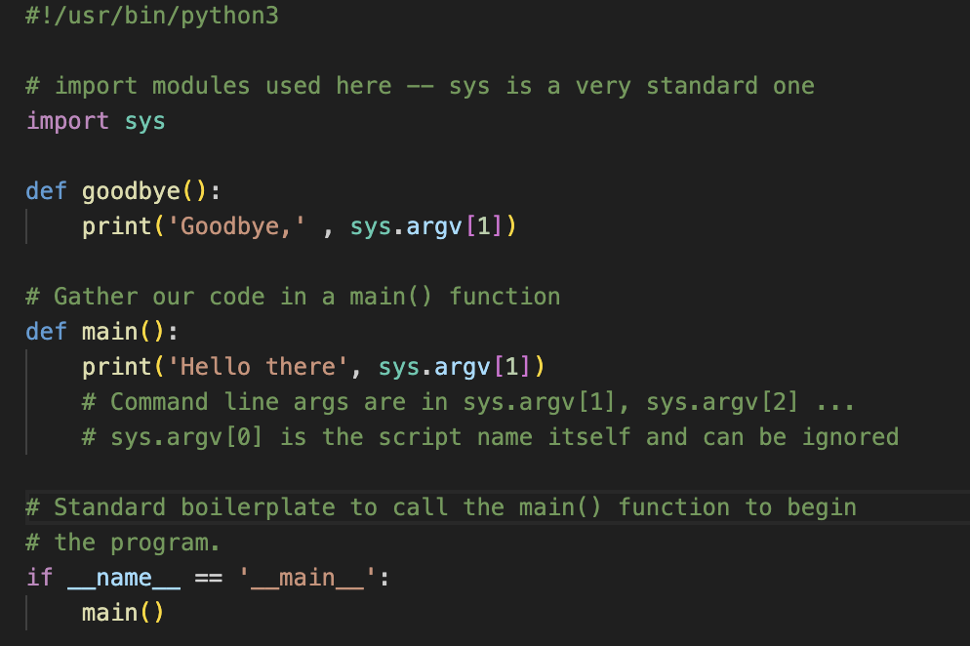
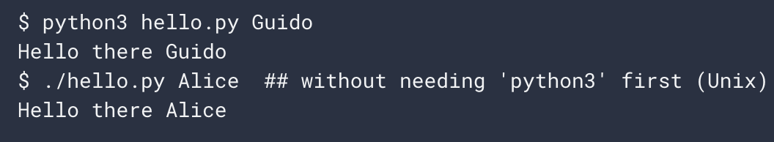
Source Code
The interactive interpreter is mainly for quick tests
When you are writing a sophisticated python program, you put it inside a .py file
hello.py

Slide 5
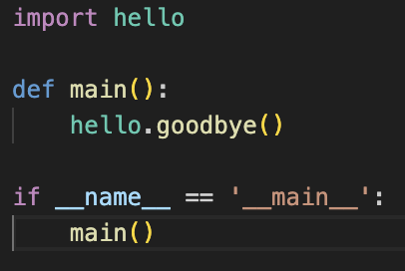
Modules
In general, python scripts are modules, meaning their functionality can be imported to other python scripts
There is a huge suite of developed modules with cool functionality you can use (after they are installed with pip)
You can even pull from your own scripts!
goodbye.py

Slide 6
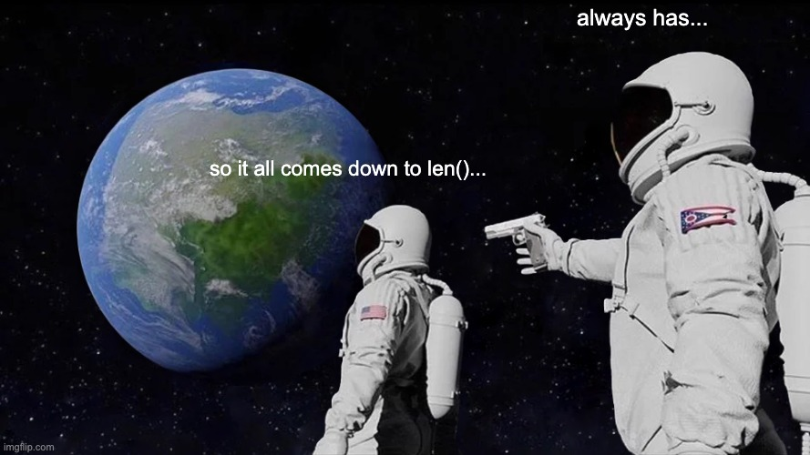
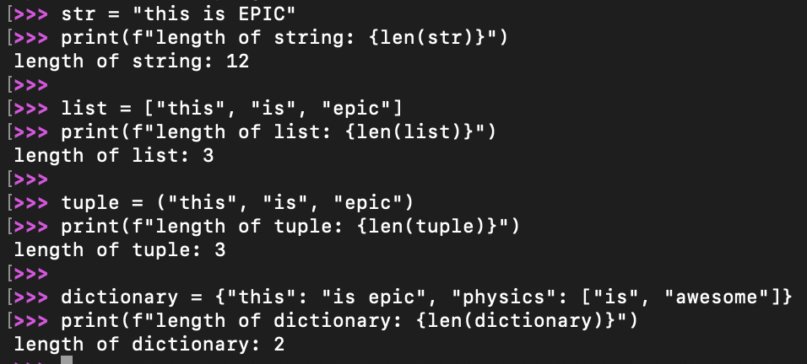
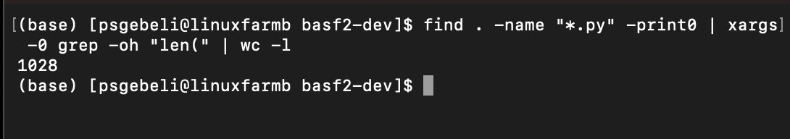
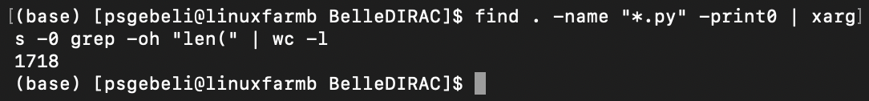
len()
Short for length
Gives you the length of several data types
  Strings → number of characters
  Lists, tuples → number of elements
  Dictionaries → number of key/value pairs

Slide 7
len()

Slide 8
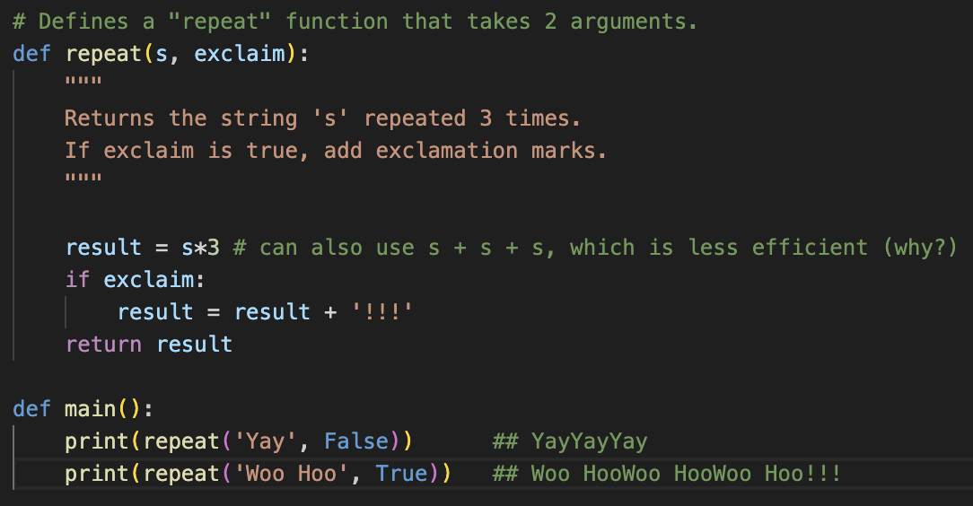

Functions
Define a function with def(): and indentation
Can define whatever parameters you want
”Docstrings” are standard practice
Functions usually return something

Slide 9
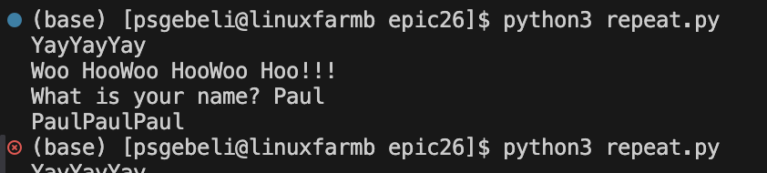
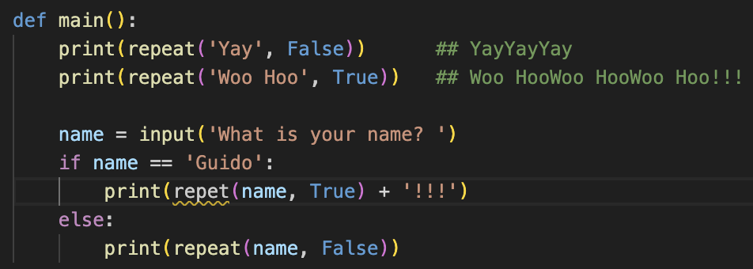

Code checked at run time
Python does not check your code for errors until you run it
Many of your first errors will be things like this; simple typos, unassigned variables.. Because its easy for your script to run without catching them
Other languages solve this with “compilation”, but you need to maintain type information. (or just use VS code)

Slide 10
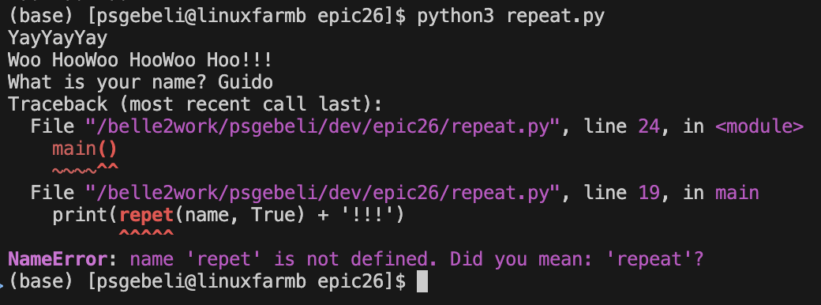
Code checked at run time
Python does not check your code for errors until you run it
Many of your first errors will be things like this; simple typos, unassigned variables.. Because its easy for your script to run without catching them
Other languages solve this with “compilation”, but you need to maintain type information. (or just use VS code)

Slide 11
Data Types

Slide 12
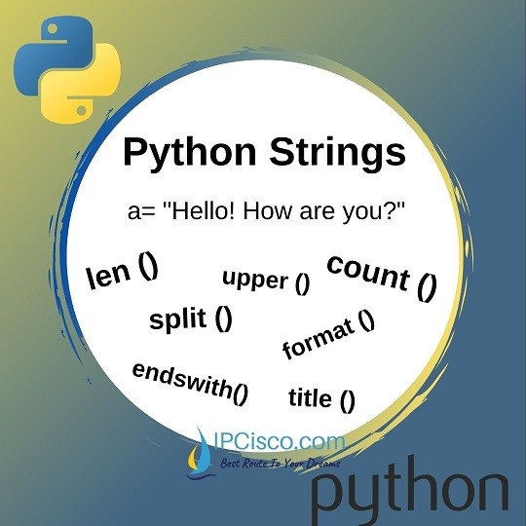
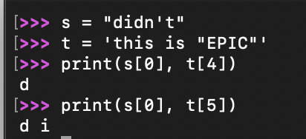
Strings
Immutable collections of characters within single quotes ‘’ or double quotes “”
Elements are accessed with [] (zero based indexing)
Strings can only be combined with other strings

Slide 13
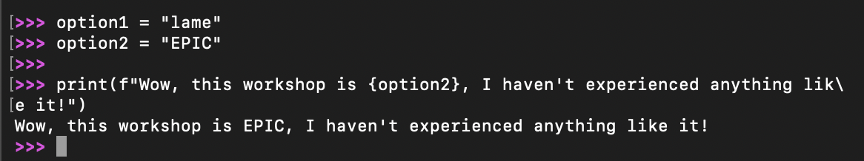
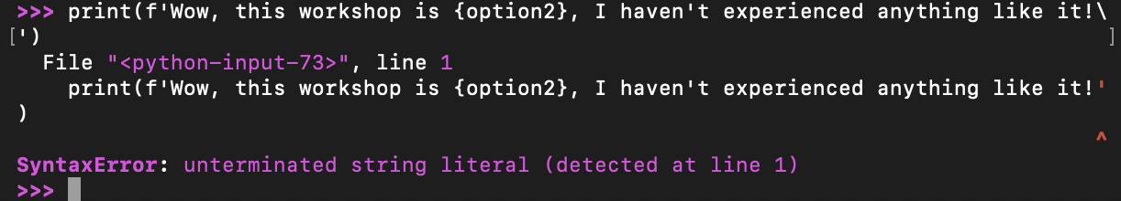
String formatting
  Objects can be automatically converted to a string for neat printing
    f-strings are very readable and useful for their additional alignment/rounding properties
    Single and double quotes work, but you can’t use the same type inside

Slide 14
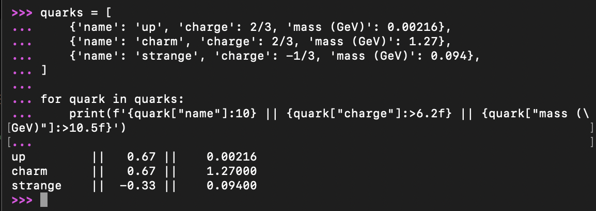
String formatting
  Objects can be automatically converted to a string for neat printing
    f-strings are very readable and useful for their additional alignment/rounding properties
    Single and double quotes work, but you can’t use the same type inside

Slide 15
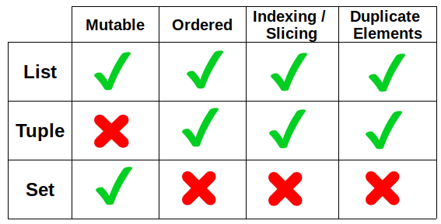
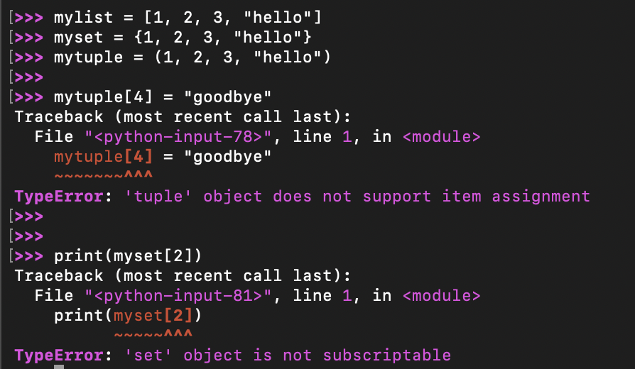
Lists, Tuples, and Sets
Lists [], sets {}, and tuples () are used for storing multiple elements, also zero-indexed.

Slide 16
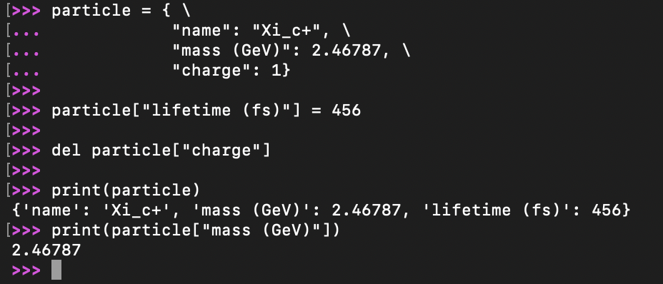
Dictionaries
Dictionaries are a mutable collection of paired data, or keys and values
You index the key rather than the location

Slide 17
Loops/Conditionals

Slide 18
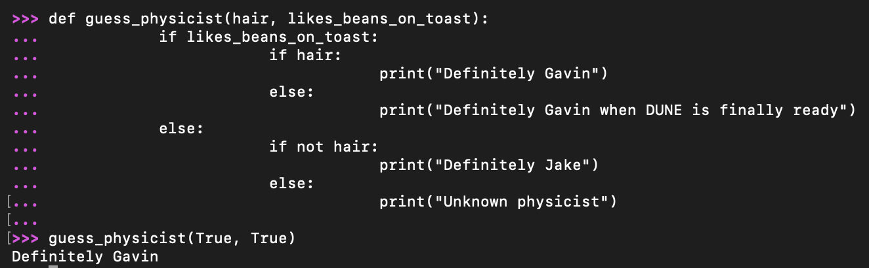
IF statements
Checks a Boolean statement, and runs the proceeding code if it is true
Can use comparison operators ==, !=, <, <=, >, >=, and, or, and not

Slide 19
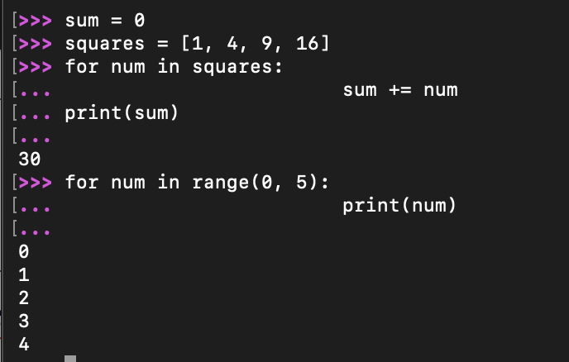
FOR and IN
Used to iterate over iterables (lists, tuples, dictionary keys, range())

Slide 20
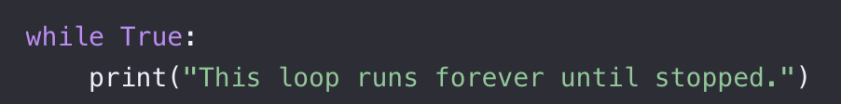
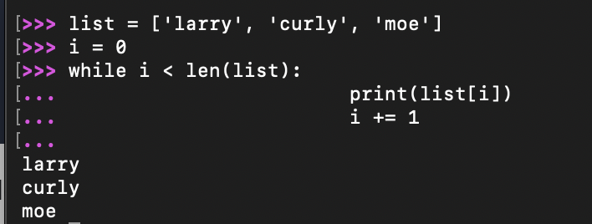
WHILE loops
WHILE something is true… do something
Don’t go infinite!!

Slide 21
Summary
Python is a current industry standard, and you should definitely learn it
It trades some speed compared to C++ for incredible readability and external module support
After 8 years of studying physics, my python knowledge and physics knowledge are comparable
There is so much more to Python that I didn’t have time to cover: Object Oriented Programming, Jupyter (see Gavin’s talk next), and so on.. Python has great documentation, though!

Slide 22
